Slide 1

CSE310: Programming in Java
Topic: Java Platform Overview

Slide 2
Outlines
Introduction
Why Java?
Where it is used?
Characteristics of Java
Java Platform Editions
Evolution of Java
Understanding JDK, JRE and JVM
How Java is platform-independent
Evaluating Java libraries, middle-ware, and database options

Slide 3
Introduction
Java is a general purpose object-oriented programming language.
Java is a high level, robust, secured and platform independent.
Developed by Sun Microsystems (James Gosling).
Platform: Any hardware or software environment in which a program runs, is known as a platform.
Notes:
Object-oriented programming (OOP) is a programming paradigm based on the concept of "objects", which may contain data, in the form of fields, often known as attributes; and code, in the form of procedures, often known as methods.

Slide 4
Why Java?
Java is the Internet programming language.
Java enables users to develop and deploy applications on the Internet for servers, desktop computers, and small hand-held devices.

Slide 5
Where it is Used?
According to Sun, 3 billion devices run java.
Desktop Applications such as acrobat reader, media player, antivirus etc.
Web Applications such as irctc.co.in, javatpoint.com etc.
Enterprise Applications such as banking applications.
Mobile Applications
Embedded System, Smart Card, Robotics, Games etc.

Slide 6
Characteristics of Java
Java Is Simple
Java Is Object-Oriented
Java Is Distributed
Java Is Interpreted
Java Is Robust
Java Is Secure
Java Is Architecture-Neutral
Java Is Portable
Java's Performance
Java Is Multithreaded
Java Is Dynamic

Slide 7
Java Platform Editions
A Java Platform is the set of APIs, class libraries, and other programs used in developing Java programs for specific applications.
Notes:
Recognizing that one size doesn’t fit all, Sun has grouped its technologies into three editions.
Java 2 Platform, Standard Edition (J2SE)
The J2SE platform is a fast and secure foundation for building and deploying client-side enterprise applications. In today's .com world of nanosecond response times and information gratification, J2SE technology provides the speedy performance and high functionality that is demanded by Web users.
For end users, J2SE technology enables faster and easier use of functionally rich Web applications, such as corporate intranets and interactive shopping aids for e-commerce. For enterprise developers, the improved J2SE technology serves as the base tool for creating sophisticated, valuable applications that can be brought to market quickly.
Java 2 Platform, Enterprise Edition (J2EE)
J2EE technology simplifies enterprise applications by basing them on standardized, modular and re-usable components called Enterprise JavaBeans™ (EJB™), providing a complete set of services to those components, and handling many details of application behavior automatically. By automating many of the time-consuming and difficult tasks of application development, J2EE technology allows enterprise developers to focus on adding value, that is, enhancing business logic, rather than building infrastructure.
Java 2 Platform, Micro Edition (J2ME)
J2ME technology specifically addresses the vast consumer space, which covers the range of extremely tiny commodities such as smart cards or a pager all the way up to the set-top box, an appliance almost as powerful as a computer. J2ME technology enables device manufacturers, service providers, and content creators to gain a competitive advantage and capitalize on new revenue streams by rapidly and cost-effectively developing and deploying compelling new applications and services to their customers worldwide.
Each edition is a developer treasure chest of tools and supplies that can be used with a particular product.
Note that there are packages developed and supported by Sun that are not part of any edition such as (java3d for 3d graphics).

Slide 8
There are 3 Java Platform Editions
1. Java 2 Platform, Standard Edition (J2SE)
  Core Java Platform targeting applications running on workstations
2. Java 2 Platform, Enterprise Edition (J2EE)
  Component-based approach to developing distributed, multi-tier enterprise applications
3. Java 2 Platform, Micro Edition (J2ME)
  Targeted at small, stand-alone or connectable consumer and embedded devices

Slide 9
Origin of Java
  James Gosling & Patrick Naughton at 1990
  Goal : to develop distributed system which is applicable to electronic products(platform independent)
Notes:
자바는 Sun에서 수행된 Green Project 도중 만들어졌다. 자바의 원래 이름은 Oak였다. James Gosling과 Patrick Naughton은 computing의 “next wave”는 digital로 제어되는 가전과 컴퓨터라고 생각해 이에 알맞은 시스템으로 만들어진 것이다.
자바개발의 목적은 연구를 위한 것이 아니라 Product를 만들어 내기 위한 것이었다. 그래서 Star 7(*7)이라는 시스템을 만들어 냈는데 이 시스템은 작은 embedded OS를 가지는 SPARC기반 Hardware이다. (Star 7은 5’’ color LCD를 가지고 touch screen을 input device로 사용하며 무선 네트워킹이 가능한 PDA이다.)
http://java.sun.com/people/jag/green

Slide 10

James Gosling
James Gosling is generally credited as the inventor of the Java programming language
He was the first designer of Java and implemented its original compiler and virtual machine
He is also known as the Father of Java.

Slide 11
Brief History of Java
In 1990, Sun Microsystems began an internal project known as the Green Project to work on a new technology.
In 1992, the Green Project was spun off and its interest directed toward building highly interactive devices for the cable TV industry. This failed to materialize.
In 1994, the focus of the original team was re-targeted, this time to the use of Internet technology. A small web browser called HotJava was written.
Oak was renamed to Java after learning that Oak had already been trademarked.
Notes:
In 1990, Sun Microsystems began an internal project known as the Green Project to work on a new technology. Its team originally considered C++ as the language to use but soon abandoned it for an entirely new language called Oak.
In 1992, the Green Project was spun off and its interest directed toward building highly interactive devices for the cable TV industry. This failed to materialize.
In 1994, the focus of the original team was re-targeted, this time to the use of Internet technology. A small web browser called HotJava was written. Oak was renamed to Java after learning that Oak had already been trademarked.
In 1995, Java was first publicly released
In 1996, Java Development Kit (JDK) 1.0 was released
In 2002, JDK 1.4 (codename Merlin) was released, the most widely used version
In 2004, JDK 5.0 (codename Tiger) was released, the latest version
The name Java was coined at a local coffee shop frequented by some of the members.
It is not clear whether the name is an acronym or not.
However some accounts claim that it stands for the names of James Gosling, Arthur Van Hoff, and Andy Bechtolsheim.
Others, that it is an acronym for Just Another Vague Acronym.

Slide 12
In 1995, Java was first publicly released.
In 1996, Java Development Kit (JDK) 1.0 was released.
In 2002, JDK 1.4 (codename Merlin) was released, the most widely used version.
In 2004, JDK 5.0 (codename Tiger) was released.
The latest version of java is jdk 8.0.

Slide 13
JDK Versions
JDK Alpha and Beta (1995)
JDK 1.0 (23rd Jan, 1996)
JDK 1.1 (19th Feb, 1997)
J2SE 1.2 (8th Dec, 1998)
J2SE 1.3 (8th May, 2000)
J2SE 1.4 (6th Feb, 2002)
J2SE 5.0 (30th Sep, 2004)
Java SE 6 (11th Dec, 2006)
Java SE 7 (28th July, 2011)
Java SE 8 (18th March, 2014)

Slide 14
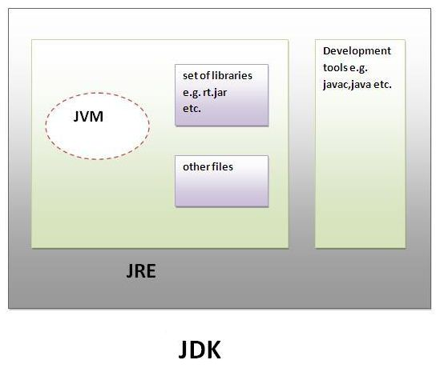
Understanding JDK, JRE and JVM

Slide 15
Understanding JDK & JRE
JDK
JDK is an acronym for Java Development Kit.
It physically exists. It contains JRE and development tools.
JRE
JRE is an acronym for Java Runtime Environment.
It is the implementation of JVM and used to provide runtime environment.
It contains set of libraries and other files that JVM uses at runtime.

Slide 16
Understanding JVM
JVM (Java Virtual Machine) is an abstract machine.
It is a specification that provides runtime environment in which java byte code can be executed.
JVMs are available for many hardware and software platforms.
The JVM performs following main tasks:
  Loads code
  Verifies code
  Executes code
  Provides runtime environment

Slide 17
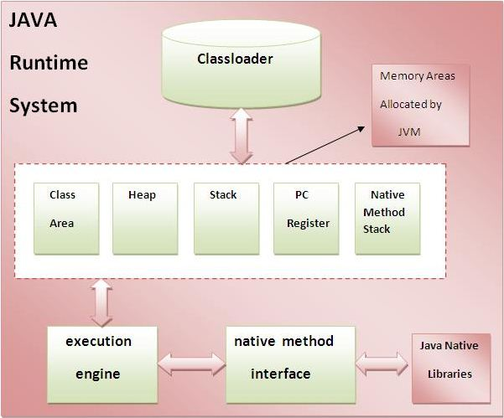
Internal Architecture of JVM

Slide 18

How Java is Platform-independent?

Slide 19
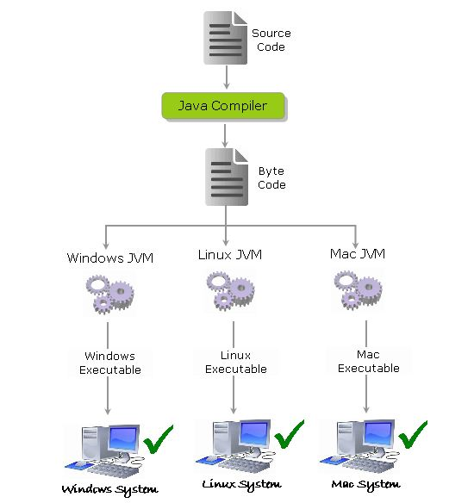
How Java is Platform-independent?

Slide 20
How Java is Platform-independent?
The source code (program) written in java is saved as a file with .java extension.
The java compiler “javac” compiles the source code and produces the platform independent intermediate code called BYTE CODE. It is a highly optimized set of instructions designed to be executed by the JVM.

Slide 21
How Java is Platform-independent?
The byte code is not native to any platform because java compiler doesn’t interact with the local platform while generating byte code.
It means that the Byte code generated on Windows is same as the byte code generated on Linux for the same java code.
The Byte code generated by the compiler would be saved as a file with .class extension. As it is not generated for any platform, can’t be directly executed on any CPU.

Slide 22
Java Libraries, Middle-ware, and Database options
java.lang
java.util
java.sql
java.io
java.nio
java.awt
javax.swing

Slide 23


